Slide 1
System Implementation

Slide 2
ReadMe
Taking a quick look at some online resources, we’ll be implementing something similar to a Machine Vision (Image Classification) solution.
Microsoft Asia’s Kinect team has implemented something very close to what we are trying to do.
https://kinecttranslation.codeplex.com/downloads/get/849238
In their code along with many other solutions, they generate a table based on key descriptor elements. This table is used to classify the incoming image.

Slide 3
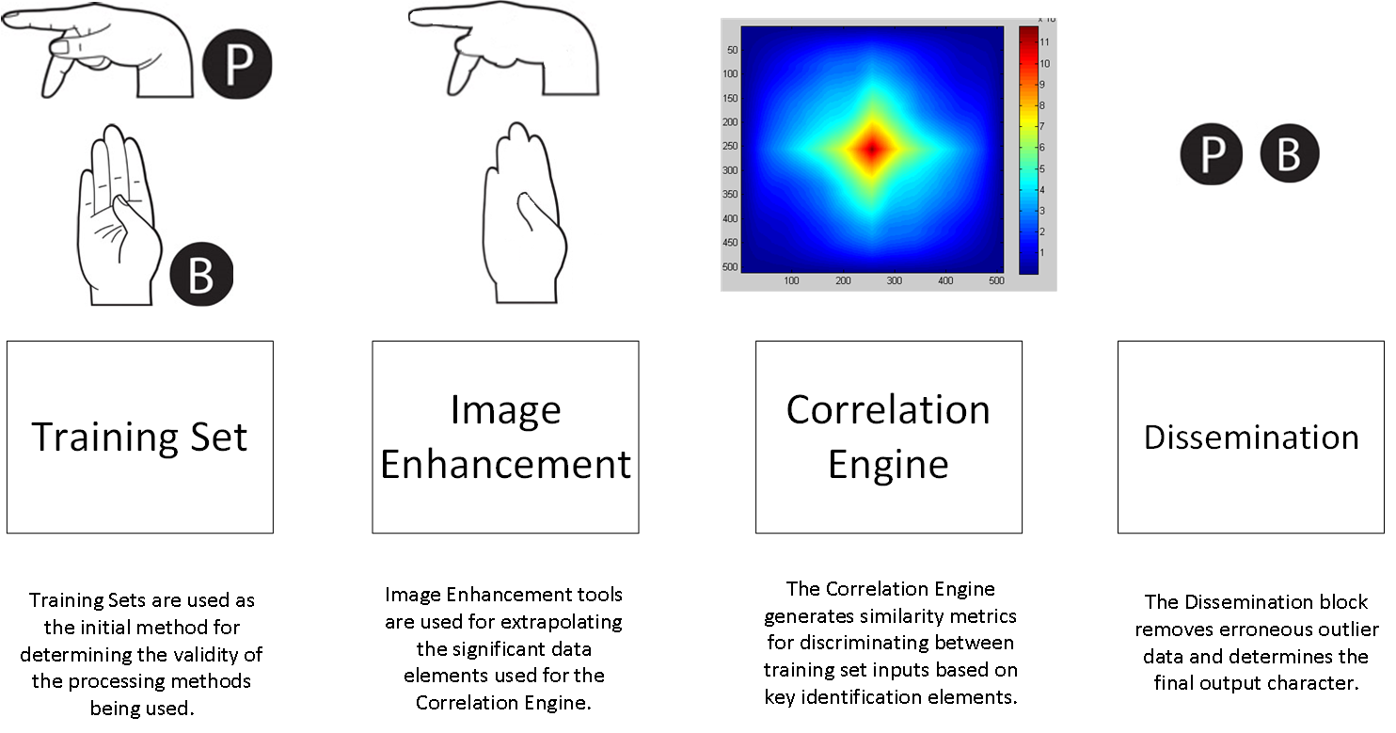
Technical Layout Pt.1

Slide 4
Training Set
Good news is that we have a training set.
We may need to remove the letters from the images if our algorithms can’t handle them.

Slide 5
Technical Layout Pt.1

Slide 6
Image Enhancement
TBD
We need to focus on the next few slides before determining what we should be enhancing.

Slide 7
Technical Layout Pt.1

Slide 8
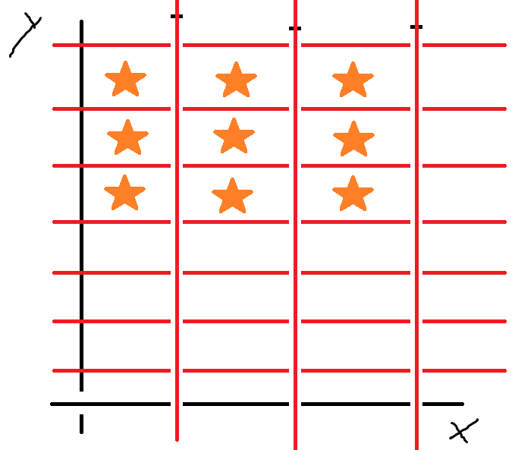
Image Descriptors
We should begin by focusing on the key descriptor elements for the sign language hands. These descriptors can be seen in the mock diagram below.
The graph has been segmented into a number of squares. (This will be the number of training images or 26 alphabet letters we have).
Each Tile represents a letter
whose descriptor has placed it in
the relative location.

Slide 9
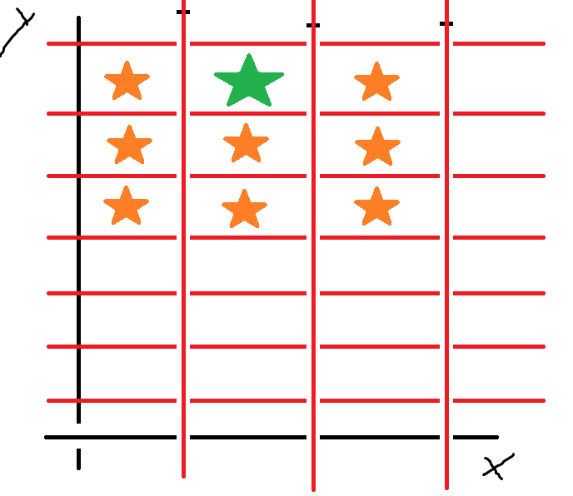
Image Descriptors
The Descriptor could be a number of things. Our first objective is to find out what this should be.
When we run our images through the algorithm to find the descriptor, we find that it relates to our training table.
The Green star indicates the
descriptor and the tile which it’s
located can be used to help
identify the input image.

Slide 10
Objective 1
Lets begin by generating the descriptors.
We need to find what elements will be best in helping us describe the training table as shown previously.
Options include Sobel Filter (Line Detection), Harris Corner Detection. Histograms, etc.

Slide 11
Technical Layout Pt.1

Slide 12
Clustering Algorithm
Once the training table has been generated, we can run our new images through the algorithm to find it’s descriptors.
Sometimes, the new descriptor will not be exactly equal to a training table value. We’ll need a clustering algorithm to help us identify which training set the new image belongs to.
Examples include the Mean Distance, K-Means, Bayes Classifier, etc.

Slide 13
Objective 2
We’ll need to generate the clustering algorithm.
This shouldn’t be too hard as Matlab has a number of functions to help in this area.
Again, another area which we should research

Slide 14
Conclusion
Things To Do
Discover Sign Language Descriptors
Generate Training Table
Code Clustering Algorithm
Forward Work
Image Enhancement Algorithms As Needed
Improve Clustering Algorithm
Add Multiple Clustering Algorithms and Add Weighting Coefficients to Improve Results

